Slide 1
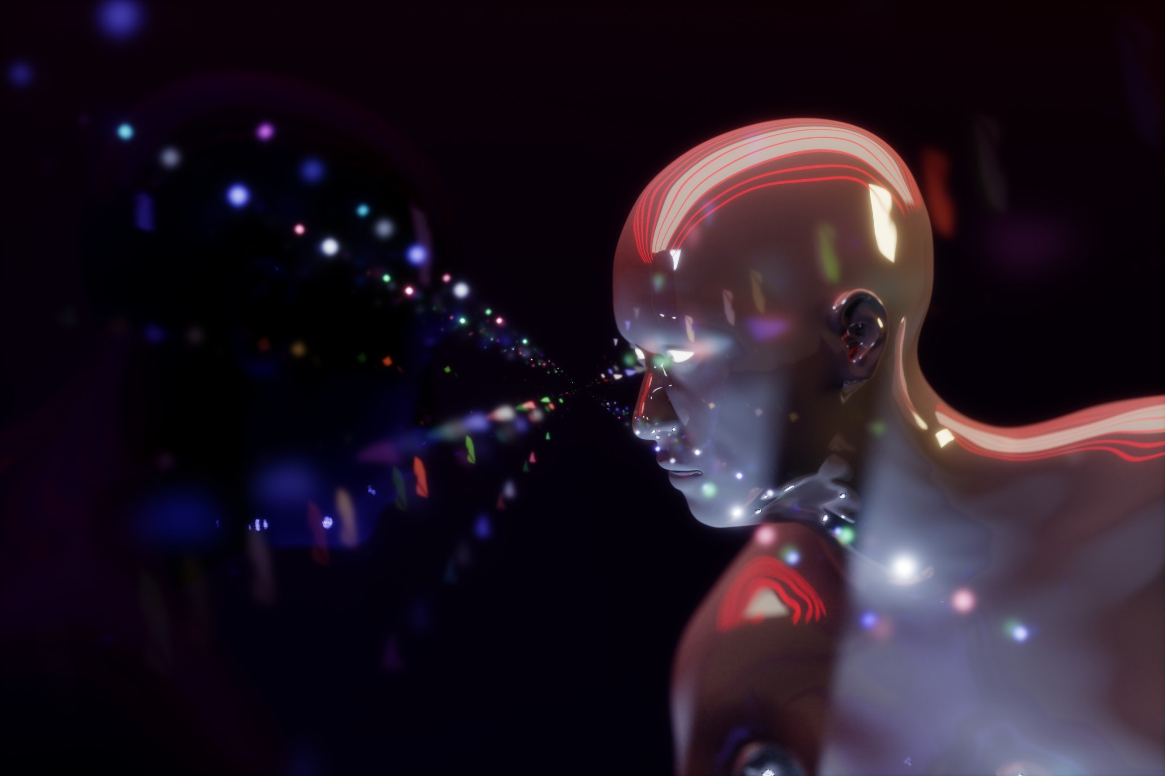
PREDICTION OF DISEASES USING ML

Slide 2
TEAM NAME : TECH CREEPERS
INSTITUTE NAME : ST.JOSEPH’S COLLEGE OF ENGINEERING ,CHENNAI OMR-119
THEME NAME : PREDICTION OF DISEASES USING ML
TEAM LEADER : GILBERT SAM M A
Branch : BE Stream : ECE Year : II
TEAM MEMBER: ABISHAI SAKTHI DEV
Branch :BE Stream : ECE Year : II

Slide 3
INTRODUCTION:
Disease detection using ML has become an increasingly popular research area in recent years due to the abundance of data available in the healthcare industry .
Machine learning algorithms can analyse large amounts of medical data and identify patterns that can be used to detect and diagnose diseases accurately.
The algorithm can then analyse new patient data and identify patterns that are associated with the disease. This can help doctors to detect diseases earlier, which can lead to more effective treatment and better outcomes for patients.

Slide 4
OBJECTIVE:
The objective of multiple disease prediction using Machine Learning (ML) is to develop models that can accurately predict the likelihood of an individual developing multiple diseases based on their medical history.
The ultimate goal is to use these models to improve disease prevention and management by providing early detection and intervention strategies for individuals at high risk of developing multiple diseases.
In this paper, we review recent research in disease prediction using ML, including techniques such as decision trees, logistic regression. In this system we had predicted three diseases
1)Diabetes
2)Heart Disease
3) Parkinson’s

Slide 5
By analyzing large amounts of data from various sources, ML algorithms can identify patterns and correlations that may not be immediately apparent to human experts.
This enables the development of predictive models that can identify individuals at high risk of developing multiple diseases, allowing healthcare professionals to provide personalized preventative care and early intervention strategies.
This approach has the potential to improve health outcomes, reduce healthcare costs, and enhance the quality of life for individuals at risk of developing multiple diseases.
PURPOSE :
Early detection ML algorithms can be trained to analyze patient data and identify early signs of multiple diseases. This can help clinicians intervene early and prevent the progression of these diseases.
Risk assessment by analyzing patient data, ML algorithms can calculate the risk of developing multiple diseases. This can help clinicians develop personalized prevention and treatment plans for patients.
It will reduces the time taken to Check the report of the Diseases

Slide 6


Diabetes dataset
Model
Generated
Heart dataset
Data Pre-processing
Parkinson's dataset
Model
Generated
PROJECT WORK FLOW
Text Data
Prediction
Result Analysis

Slide 7
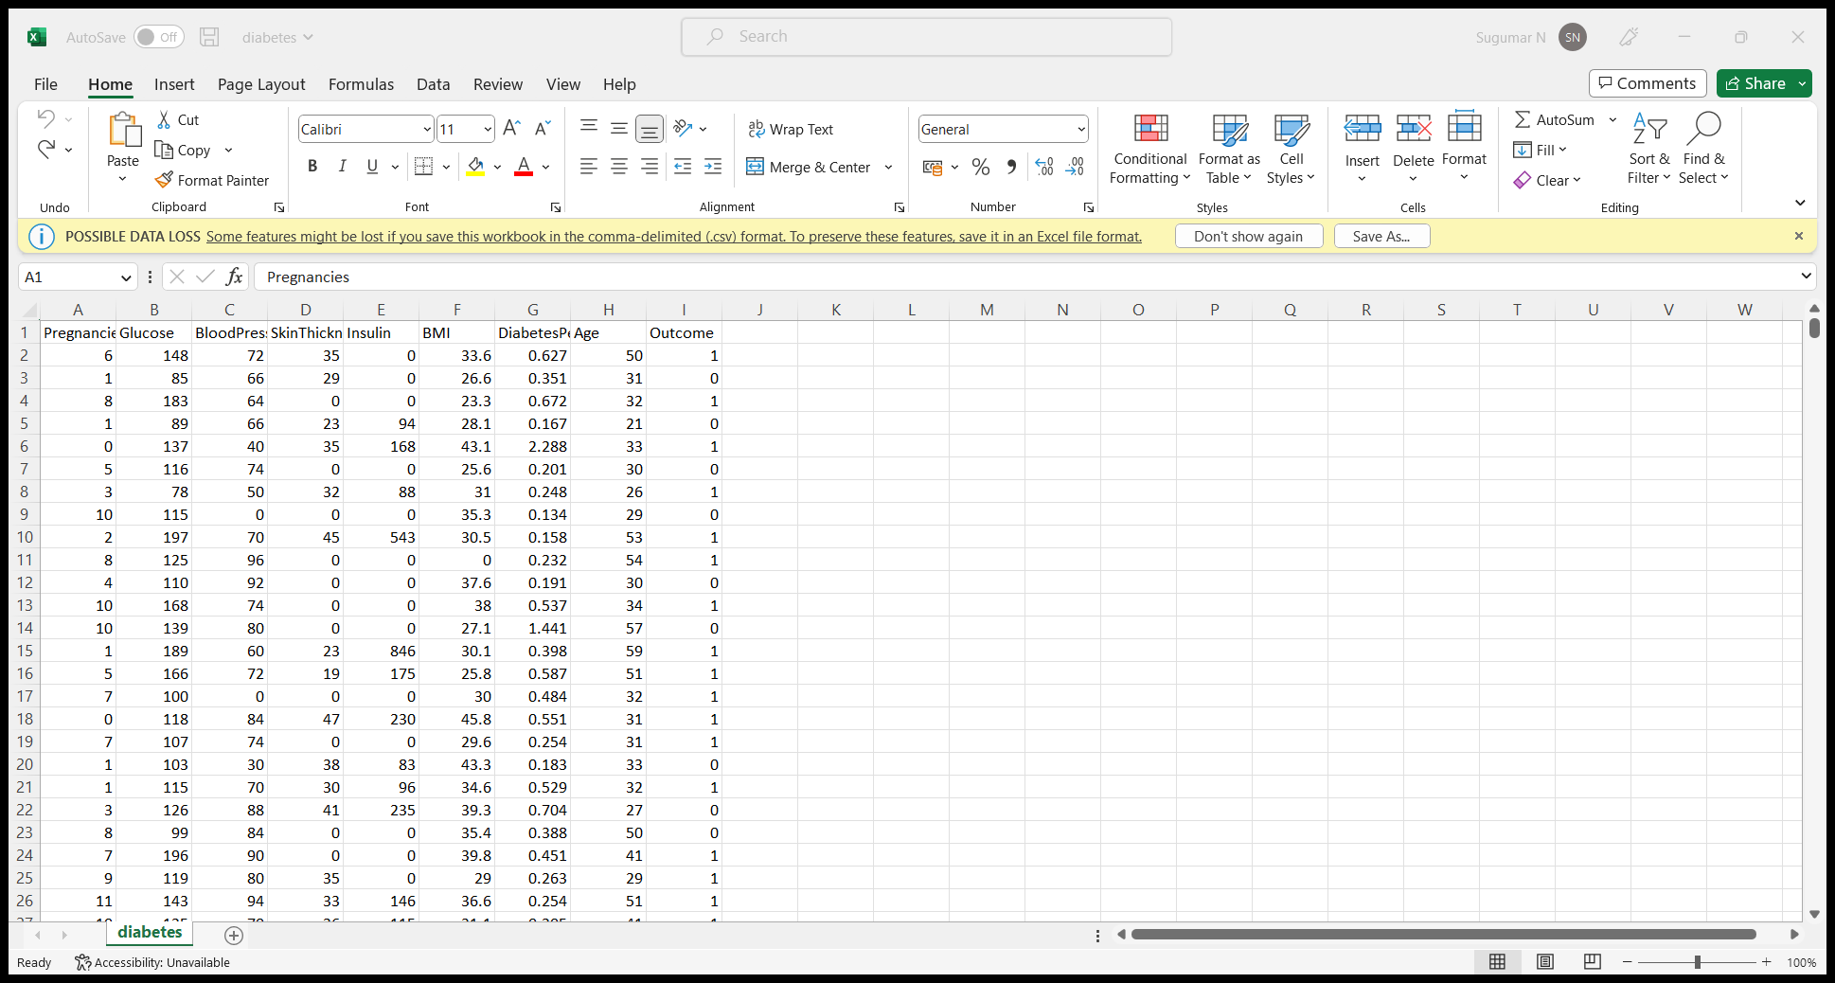
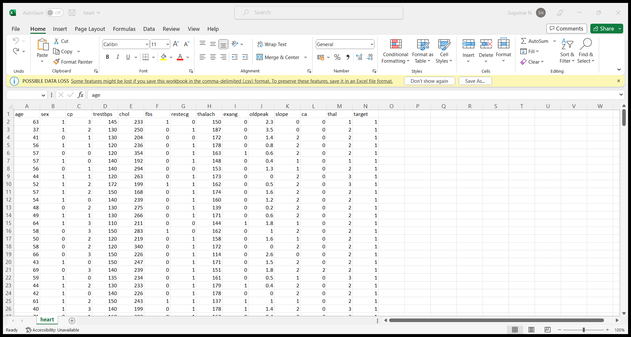
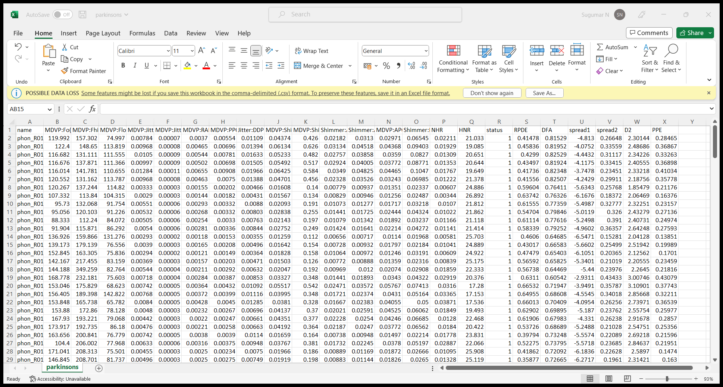
Data Set

Slide 8
TECH STACK :
Streamlit
Front end
Python
Back end
Excel sheet
Data set

Slide 9
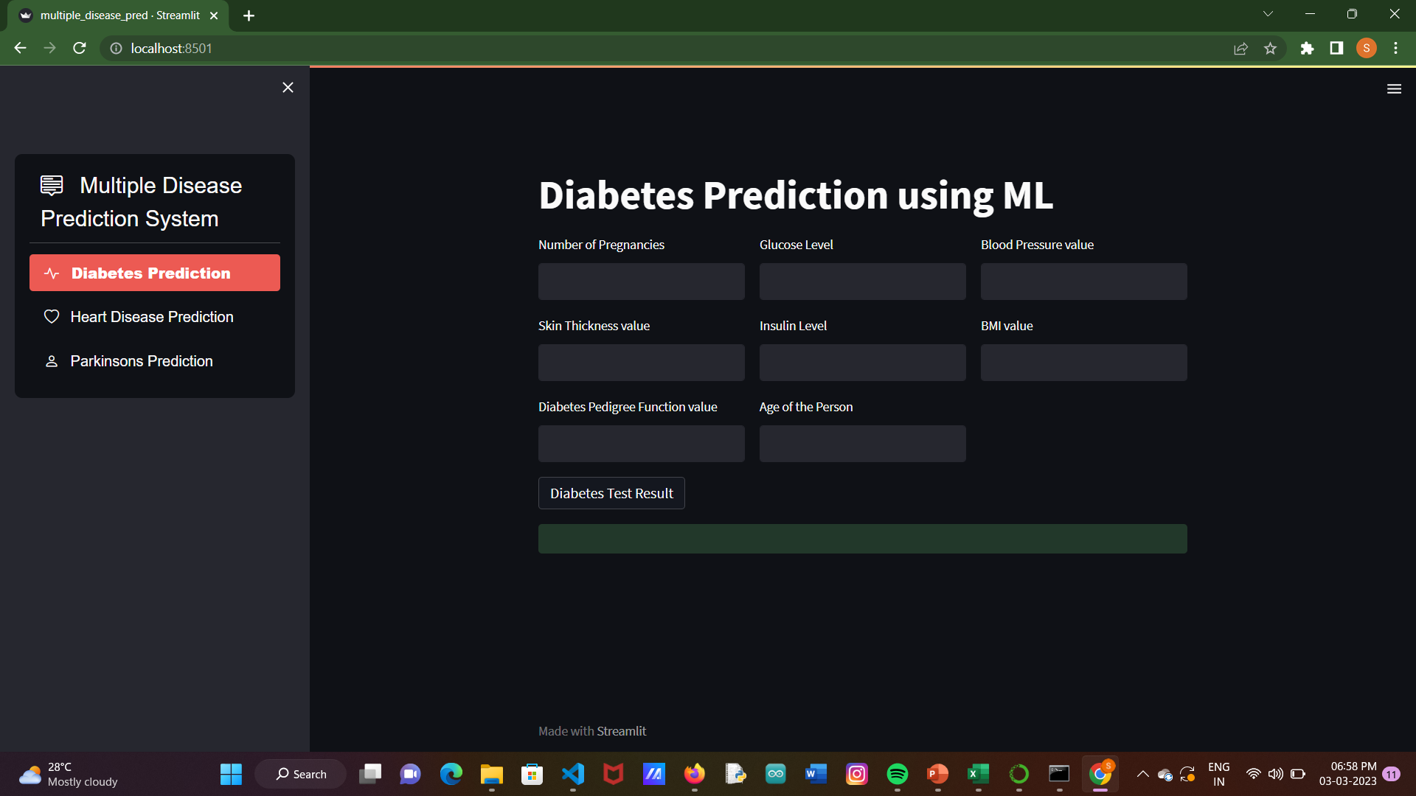

Slide 10
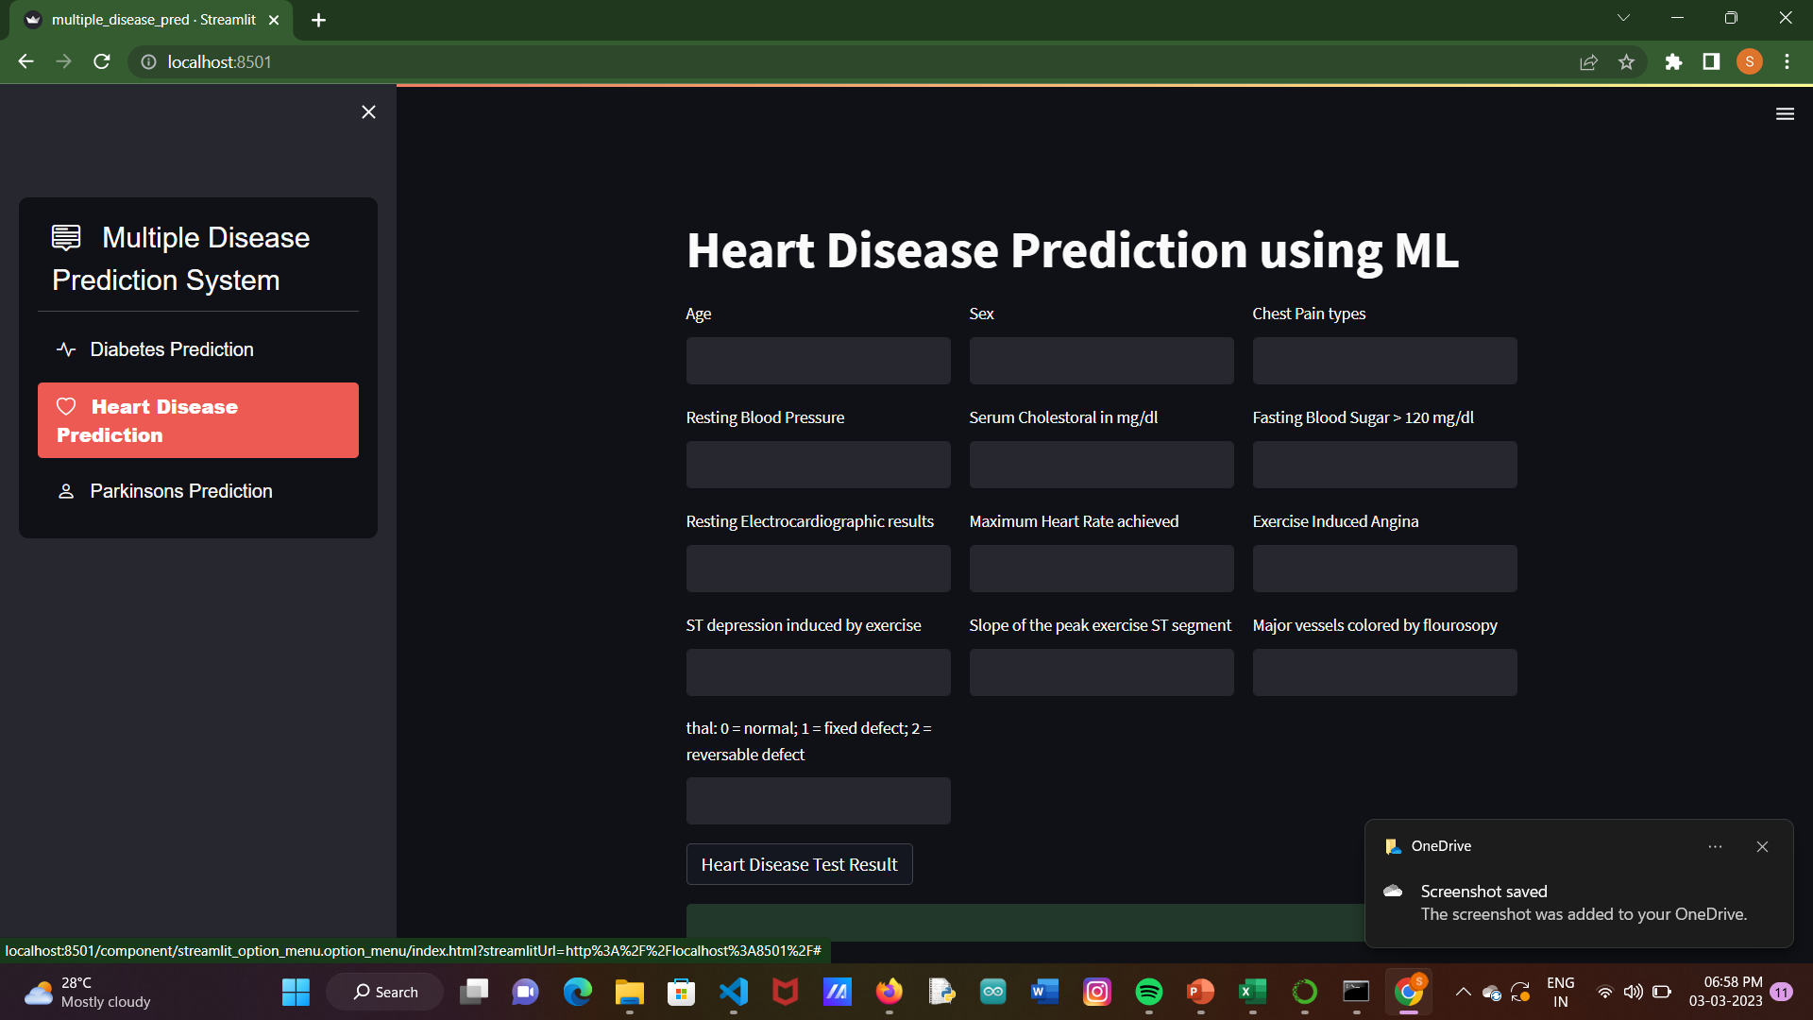

Slide 11
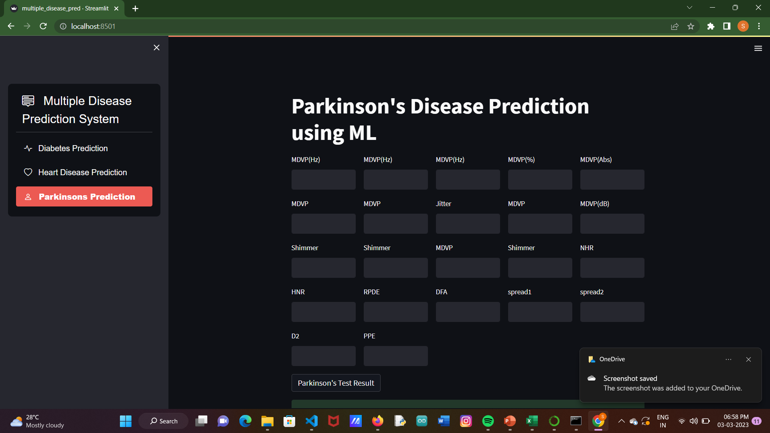

Slide 12


